Slide 1
TASK 2: CONTAINERIZE AUXILIARY APPLICATION SERVICES (DOCKER)

Slide 2
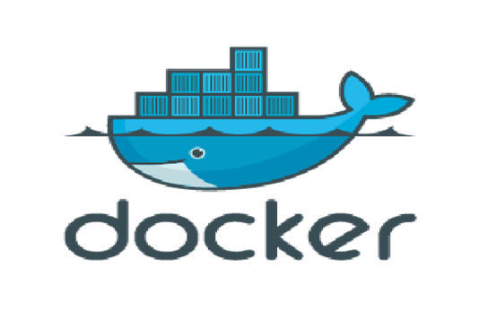
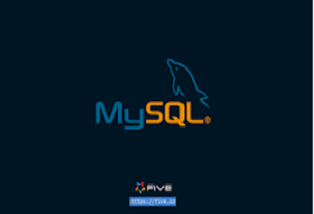

INTRODUCTION:
Docker is an open-source platform that allows you to develop, deploy, and run applications in containers.
Containers are lightweight, portable, and self-sufficient environments that package an application and all its dependencies. This makes it easy to ensure that your application runs consistently across different environments, from development to production.
The process of installing Docker on Ubuntu, and then demonstrate how to create a database inside a Docker container.

Slide 3

WHAT IS DOCKER?
Docker is an open-source platform that allows developers to automate the deployment, scaling, and management of applications in lightweight, portable containers.
Containers package an application and its dependencies (such as libraries, configurations, and environment variables) into a single unit, ensuring the application runs consistently across different environments (e.g., development, testing, production) without compatibility issues.

Slide 4
KEY CONCEPTS OF DOCKER:
Containers: These are lightweight, standalone, executable packages that include everything needed to run a piece of software (code, runtime, libraries, and system tools). They are isolated from the host system, making them highly portable and reproducible.
Docker Images: These are read-only templates used to create containers. An image contains the application and all its dependencies. Docker images can be pulled from public repositories like Docker Hub or created from a Dockerfile.

Slide 5
KEY CONCEPTS OF DOCKER:
Dockerfile: A script containing a series of instructions on how to build a Docker image. It typically includes things like installing dependencies, setting environment variables, copying files, and specifying the default command to run when the container starts.
Docker Engine: The core component of Docker, responsible for building, running, and managing containers. It consists of the Docker Daemon (which manages containers) and the Docker CLI (command-line interface) for interacting with the daemon.

Slide 6
KEY CONCEPTS OF DOCKER:
Docker Hub: A cloud-based registry service where Docker users can share and access pre-built Docker images. Docker Hub hosts a wide range of public images, such as popular databases, web servers, and development tools.
Volumes: A way to persist data outside of containers. Since containers are ephemeral, volumes are used to store data that needs to survive container restarts or removals.
Docker Compose: A tool for defining and running multi-container Docker applications. It allows you to specify the services, networks, and volumes needed for an application in a single YAML file, simplifying complex setups.

Slide 7
BENEFITS OF DOCKER:
Portability: Docker containers can run on any system that supports Docker, regardless of the underlying operating system.
Consistency: By packaging everything an application needs into a container, Docker ensures that the app will run consistently across different environments.
Isolation: Docker containers provide process and filesystem isolation, which makes it easier to run multiple applications on the same host without conflicts.
Efficiency: Containers are lightweight and use fewer resources compared to traditional virtual machines, leading to faster startup times and less overhead.

Slide 8
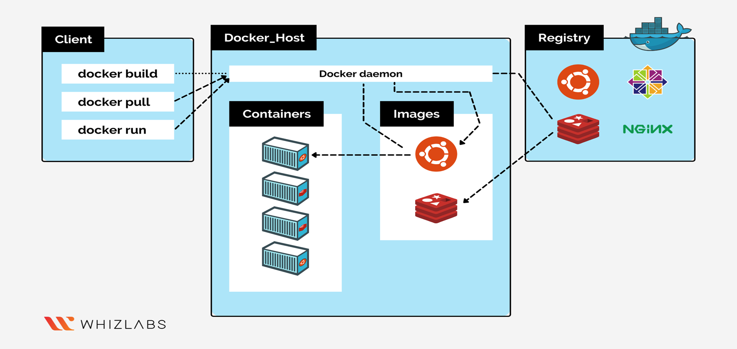
DOCKER ARCHITECTURE:

Slide 9
WHAT IS DOCKER CLIENT?
The Docker client is a command-line interface (CLI) tool used to interact with Docker services and manage Docker containers, images, networks, and volumes. It's the primary way users interact with the Docker platform.
docker build: Create a new Docker image from a Dockerfile.
docker run: Create and start a container from an image.
docker pull: Download an image from a registry.

Slide 10
WHAT IS DOCKER HOST?
A Docker host is the machine where Docker is installed and where Docker containers run.
It includes the Docker daemon, which manages containers and images, and provides an environment for creating and running applications in containers.
Docker hosts can be local or remote, and they can be part of a cluster for scaling and orchestration

Slide 11
WHAT IS DOCKER REGISTRY?
A Docker Registry is a service that stores and manages Docker images.
It acts as a central repository where Docker images can be stored, shared, and retrieved.
Docker registries allow users to upload (push) images they have built, as well as download (pull) images from a central location.
A Docker Registry is a centralized place to store Docker images that can be pulled, pushed, and managed.

Slide 12
WHAT IS DOCKER HUB?
Docker Hub is a cloud-based registry service provided by Docker that allows users to store, share, and manage Docker images. It is the default registry that Docker clients pull images from when no other registry is specified.
Docker Hub is the default registry where Docker images are stored and shared.
You can pull, push, and manage Docker images using Docker Hub.
Public repositories are free, while private repositories require a paid account.
Docker Hub allows for versioning of images, automated builds, and easy sharing with other Docker users.

Slide 13
DOCKER FILE COMPONENTS:
A Dockerfile is a text file that contains a set of instructions for building a Docker image.
It defines how to assemble the Docker image, including the base image, dependencies, configuration, and the application itself.
Each instruction in a Dockerfile creates a new layer in the image, which is cached for faster builds in subsequent executions.

Slide 14
EXAMPLE OF A COMPLETE DOCKER FILE:
# Use the official MySQL image as the base
FROM mysql:5.7
# Set environment variables for MySQL (you can replace them with your own settings)
ENV MYSQL_ROOT_PASSWORD=rootpassword
ENV MYSQL_DATABASE=mydatabase
ENV MYSQL_USER=myuser
ENV MYSQL_PASSWORD=mypassword
# Optionally, copy initialization scripts into the container to set up the database schema
COPY ./init.sql /docker-entrypoint-initdb.d/
# Expose the default MySQL port
EXPOSE 3306

Slide 15
WHAT IS DATABASE?
A database is an organized collection of data that is stored and managed electronically, typically in a digital format.
The data is structured in a way that allows for easy access, management, modification, and retrieval.
Databases are used to store all types of information, from simple text records to complex datasets, and are critical for many applications, ranging from websites to enterprise software and scientific research.

Slide 16
WHAT IS MYSQL?
MySQL is an open-source relational database management system (RDBMS) that uses Structured Query Language (SQL) to manage and interact with databases.
It is one of the most popular RDBMSs due to its reliability, speed, and ease of use.
MySQL is used to store, manage, and retrieve data for web applications, enterprise software, and other systems that require persistent data storage.

Slide 17
CONTAINER VS VOLUME:

Slide 18
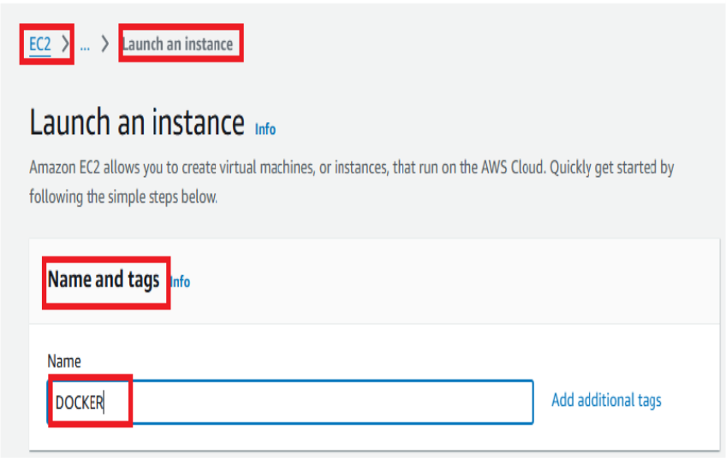
STEP 1:LAUNCH AN INSTANCE
1.Click on the EC2 service in AWS Management Console 2.Click on the launch instance. 3.while launching the instance firstly click on the Name and tags(any name) and the following images are shown below.

Slide 19
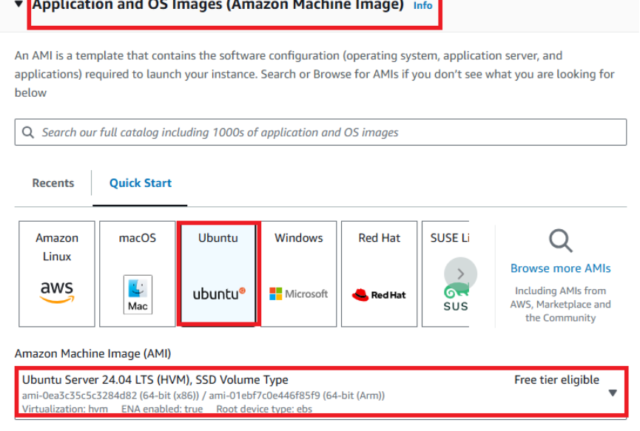
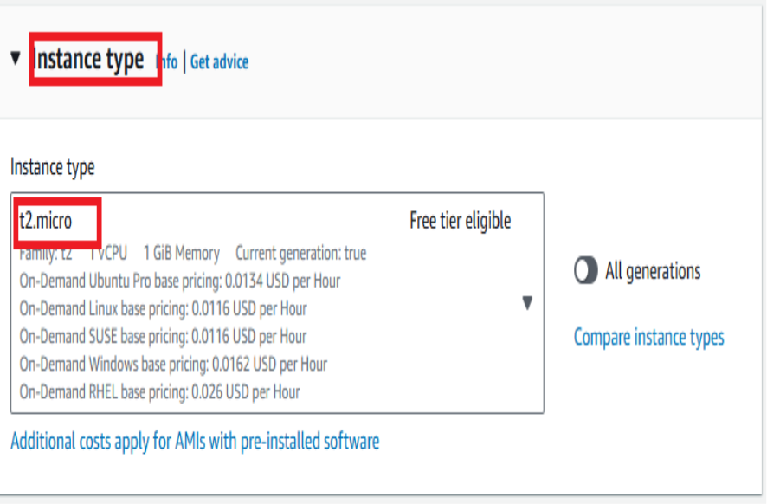
4.Application and OS Images(Amazon machine image) choose ubuntu. 5.Instance type(t2.micro) and the following images are shown below.

Slide 20
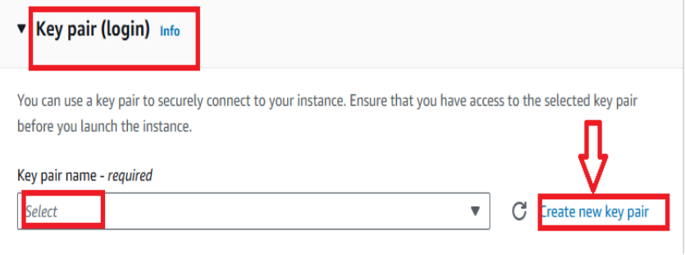

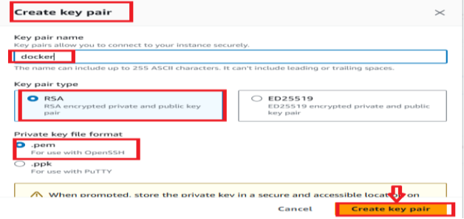
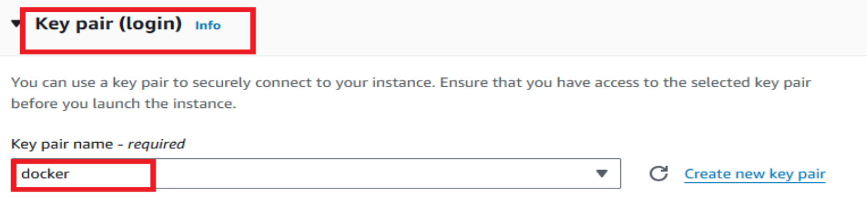
6.key pair (login)
create key pair or select the existing key pair name.
The below images shows that the key pair login --create key pair--select the existing key pair.

Slide 21
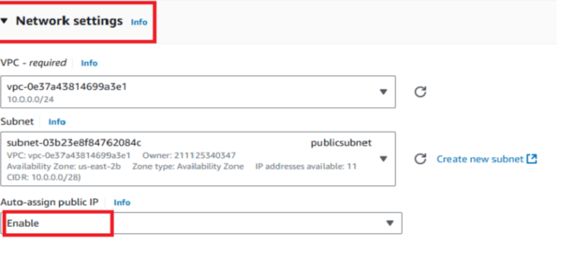
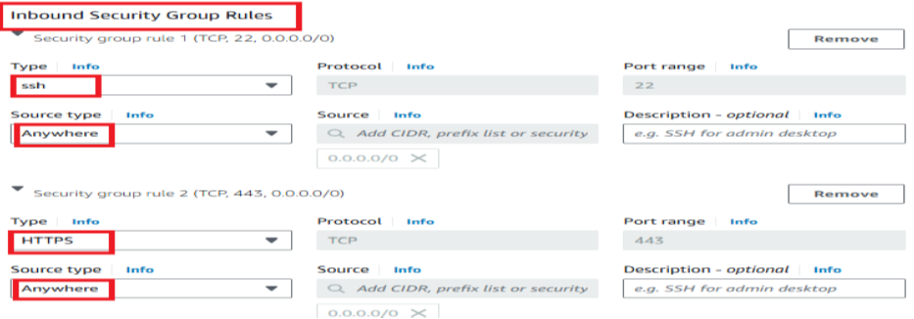
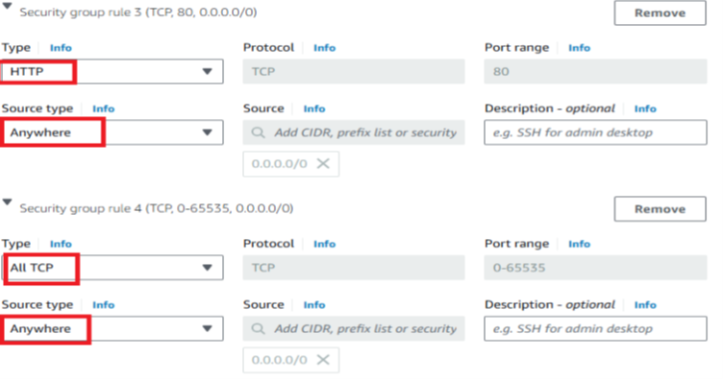
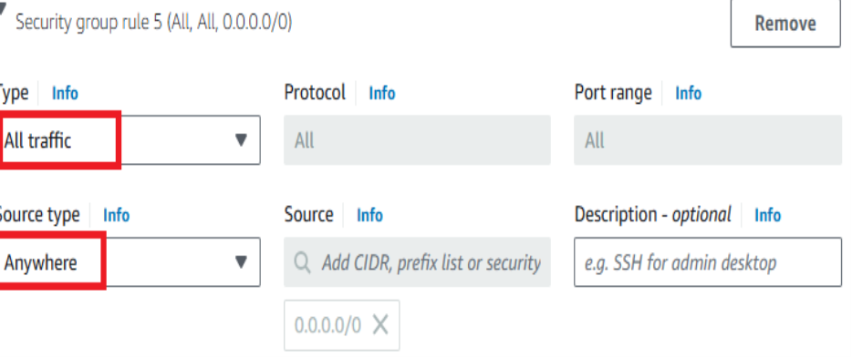
7.network settings(vpc,subnet and auto-assign public IP). 8.Inbound security group rules Select --ssh--http--https--all tcp--all traffic--anywhere.
The following images are shown below.

Slide 22
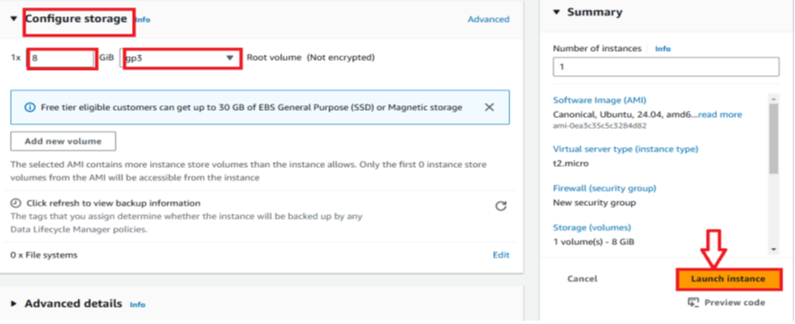
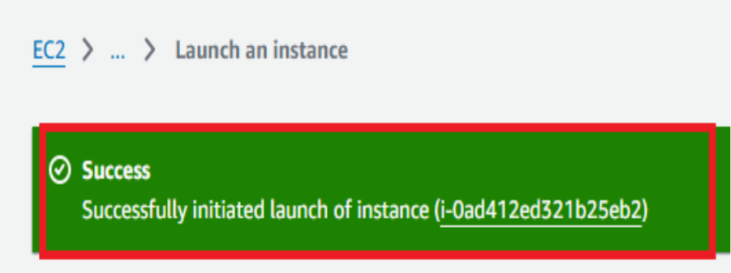
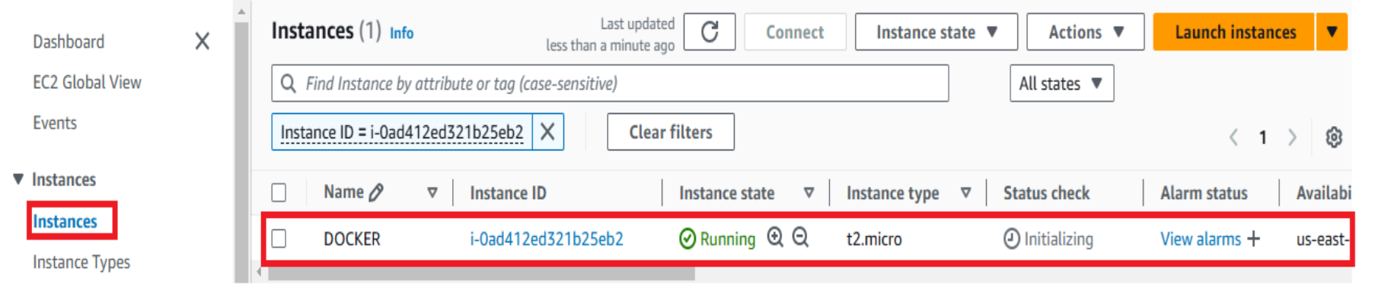
9.configure storage and after click on the launch instance. The below images shows the ec2 instance is running successfully.

Slide 23
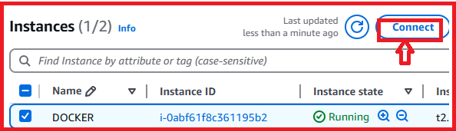
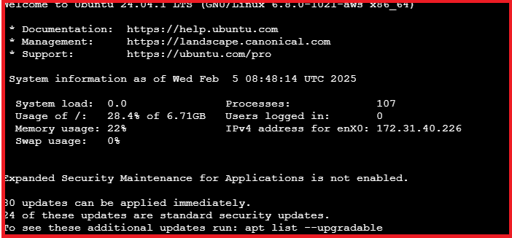
10.The instance is running and connect with .pem file or ec2 instance connect.
The following images are shown below.

Slide 24
STEP 2:STEPS ARE INVOLVING TO CREATE DOCKER CONTAINER WITH DATABASE:
sudo apt update
sudo apt upgrade
sudo apt install apt-transport-https ca-certificates curl software-properties-common
curl -fsSL https://download.docker.com/linux/ubuntu/gpg | sudo gpg --dearmor -o /usr/share/keyrings/docker-archive-keyring.gpg
echo "deb [arch=amd64 signed-by=/usr/share/keyrings/docker-archive-keyring.gpg] https://download.docker.com/linux/ubuntu $(lsb_release -cs) stable" | sudo tee /etc/apt/sources.list.d/docker.list > /dev/null
sudo apt update

Slide 25
sudo apt install apt-transport-https ca-certificates curl software-properties-common
sudo apt install docker.io
sudo systemctl start docker
sudo systemctl enable docker
sudo systemctl status docker
sudo docker –version
sudo usermod -aG docker $USER
newgrp docker
docker run hello-world
docker pull mysql:latest
docker run --name mysql-container -e MYSQL_ROOT_PASSWORD=my-secret-pw -d -p 3306:3306 mysql:latest
docker exec -it mysql-container mysql -u root -p

Slide 26
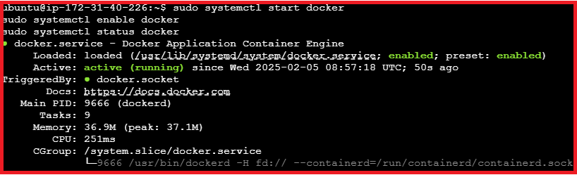
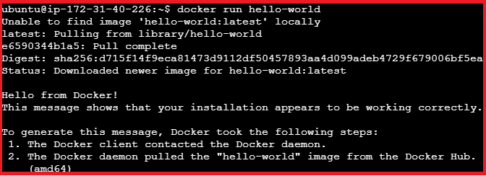
The docker is running and the following image is shown below.
The docker run hello world and the following image is shown below.

Slide 27
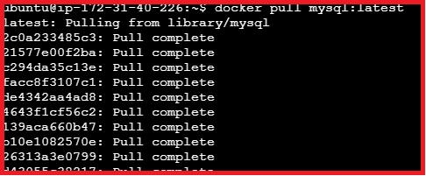
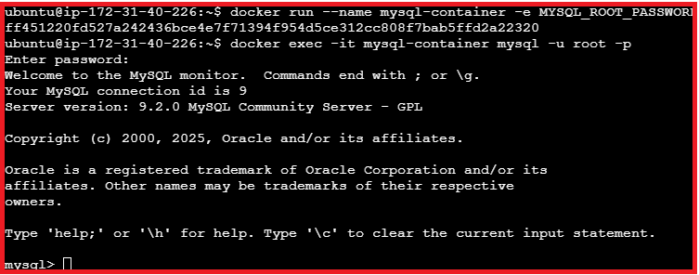
The docker pull mysql:latest and the following image is shown below.
The docker run --name mysql-container -e MYSQL_ROOT_PASSWORD=my-secret-pw -d -p 3306:3306 mysql:latest
and the following is shown below.

Slide 28
STEP 3:TO CREATE DOCKER DATABASE
CREATE DATABASE covid_data_db;
USE covid_data_db;
CREATE TABLE covid_data (
id INT AUTO_INCREMENT PRIMARY KEY,
country VARCHAR(255) NOT NULL,
total_cases INT DEFAULT 0,
total_deaths INT DEFAULT 0,
total_recoveries INT DEFAULT 0,
active_cases INT DEFAULT 0,
critical_cases INT DEFAULT 0,
cases_per_million INT DEFAULT 0,
last_updated TIMESTAMP DEFAULT CURRENT_TIMESTAMP
);

Slide 29
SHOW TABLES;
INSERT INTO covid_data (country, total_cases, total_deaths, total_recoveries, active_cases, critical_cases, cases_per_million)
VALUES
('USA', 100000000, 1100000, 98500000, 400000, 5000, 300000),
('India', 45000000, 500000, 44000000, 500000, 2000, 32000),
('Brazil', 35000000, 700000, 34000000, 300000, 4000, 160000),
('UK', 30000000, 250000, 29500000, 250000, 2000, 420000),
('Australia', 15000000, 20000, 14800000, 180000, 1500, 500000);
SELECT * FROM covid_data;

Slide 30
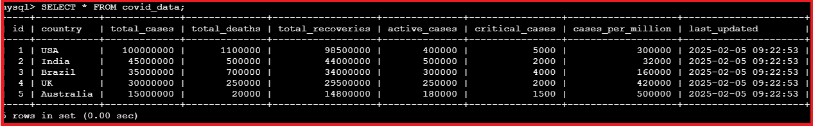
The following table is shown below.

Slide 31
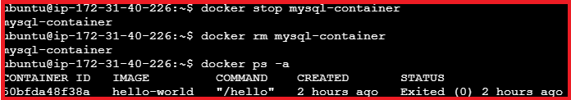
exit
docker stop mysql-container
docker rm mysql-container
docker ps –a
The following image is shown below.

Slide 32
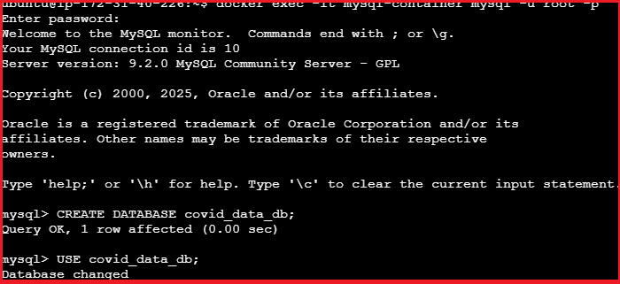
STEP 4:TO CREATE DOCKER VOLUME
docker volume create mysql_data
docker run -d --name mysql-container -e MYSQL_ROOT_PASSWORD=rootpassword -v mysql_data:/var/lib/mysql mysql:latest
docker exec -it mysql-container mysql -u root -p
CREATE DATABASE covid_data_db;
USE covid_data_db;
The following image is shown below.

Slide 33
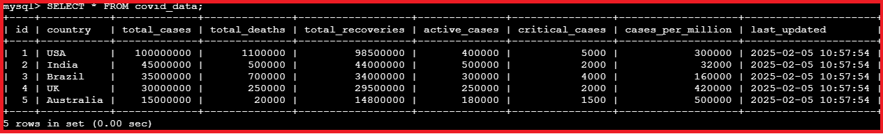
INSERT INTO covid_data (country, total_cases, total_deaths, total_recoveries, active_cases, critical_cases, cases_per_million)
VALUES
('USA', 100000000, 1100000, 98500000, 400000, 5000, 300000),
('India', 45000000, 500000, 44000000, 500000, 2000, 32000),
('Brazil', 35000000, 700000, 34000000, 300000, 4000, 160000),
('UK', 30000000, 250000, 29500000, 250000, 2000, 420000),
('Australia', 15000000, 20000, 14800000, 180000, 1500, 500000);
SELECT * FROM covid_data;
The following image is shown below.

Slide 34
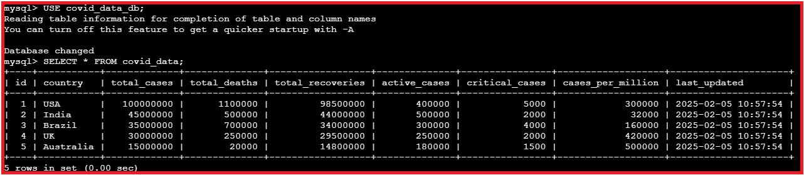
exit
docker stop mysql-container
docker stop mysql-container
docker run -d --name mysql-container -e MYSQL_ROOT_PASSWORD=rootpassword -v mysql_data:/var/lib/mysql mysql:latest
docker exec -it mysql-container mysql -u root –p
USE covid_data_db;
SELECT * FROM covid_data;

Slide 35
CONCLUSION:
Container: Containers are temporary and ephemeral. When you stop or remove a container, any data inside the container's filesystem is lost (unless explicitly stored elsewhere, like in volumes).
Volume: Volumes are persistent. The data stored in a volume remains intact even if the container using it is stopped, removed, or recreated.

Slide 36


